Slide 1
medCafe
A MITRE Research Project
Gail Hamilton : ghamilton@mitre.org
Jeff Hoyt : jchoyt@mitre.org
Mary Greer : mgreer@mitre.org
April 28th, 2011
MITRE Internal Information

Slide 2
Outline
medCafe Overview
Demonstration
Modularity in Design
Impacts/ Feedback
Lessons Learned

Slide 3
medCafe Goal
Goal: To demonstrate ways to improve interaction with patient records and increase efficiency to allow clinicians more time to interact with patient
Problem Addressed: Electronic Health Record (EHR) frustrations with:
Multiple data sources
“one size fits all” UI
Difficult to add new capabilities
Outside records/images
To demonstrate ways to give
caregivers more time to do what matters most
Notes:
Multiple Data sources. No standard – too many standards
EHRs don’t communicate seamlessly
One size – different people, different roles, need to see different aspects of patient health record. And each patient will have specific data and unique information.
No way to highlight what is important.
Outside Records: Dr estimates 80% workload is taken dealing with these records
Uncategorized scanned in pdfs. Generally labeled with radiologist name. No real way to distinguish what it shows without looking at it.
And many more issues….
CCoD Principles:
Allow for a composable interface, giving users maximum flexibility to configure the interface to their needs
Create a framework in which to run standalone composable components
Create a set of standalone components that can be composed together to build a complete patient record.
Use an accepted data standard for all communication to components
Allow for distributing and creation of templates that mirror physician's workflow

Slide 4





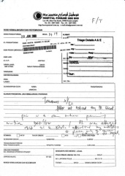
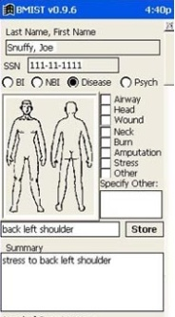


VA: The Current Workflow
Phone
Email
Fax
Vista
AHLTA
Outside Records
Has 15 minutes per patient
Notes:
They have, on average only 15 minutes to spend with each patient.
And have even less face time with a patient.
In this time they must
access the situation ,
to diagnose problem and
verify that old and new data confirms/ refutes this hypothesis
recommend treatment
To do this the doctor has to sift through a large amount of information, from various sources some of it not readily available.
These sources of information include:
VISTA – The system that they will currently be using to store patient records, or using as a messaging system
Email – generally Outlook
Fax – for any information that has been faxed from other clinicians or from outside sources
Phone – After a phone call, the physician has to write down the salient points of the call
And any scanned in records that are generically labeled “outside records”, and ,may include records from
AHLTA – The DoD medical system.
As a physician put it: “Everyday you need to search all these sources of information for data.”
Which leads to this…
All this information must be searched through and correlated in the physician’s head.
Which leads to this…

Slide 5
MedCafe Objectives
We built a prototype to explore these issues
Web based (fully web 2.0)
Extensible architecture
CCoD¹ principles
Allow for Best of Breed
Collaborate with SMEs (Dr. Donohue)
SME Wish List
Prototype applying a modular system design to the healthcare domain. Specifically, examine:
Feasibility of composable approach
Engineering issues encountered
Potential future issues
¹Composable Capability on Demand
Notes:
Multiple Data sources. No standard – too many standards
EHRs don’t communicate seamlessly
One size – different people, different roles, need to see different aspects of patient health record. And each patient will have specific data and unique information.
No way to highlight what is important.
Outside Records: Dr estimates 80% workload is taken dealing with these records
Uncategorized scanned in pdfs. Generally labeled with radiologist name. No real way to distinguish what it shows without looking at it.
And many more issues….
CCoD Principles:
Allow for a composable interface, giving users maximum flexibility to configure the interface to their needs
Create a framework in which to run standalone composable components
Create a set of standalone components that can be composed together to build a complete patient record.
Use an accepted data standard for all communication to components
Allow for distributing and creation of templates that mirror physician's workflow

Slide 6


Composable Design Principles
Allow for a composable interface, giving users maximum flexibility to configure the interface to their needs
Create a framework in which to run standalone components
Create an example set of standalone components that demonstrate what is necessary to build a complete patient record using the framework
Use an accepted data standard for all component communication, the loose coupler allows maximum sharing, flexibility
Use Layers in Architecture
Consumers
Producers
hData
Health data
Repositories
RESTful
services
Data Display
Components:
Loose
Coupler
¹Composable Capability on Demand
Notes:
Multiple Data sources. No standard – too many standards
EHRs don’t communicate seamlessly
One size – different people, different roles, need to see different aspects of patient health record. And each patient will have specific data and unique information.
No way to highlight what is important.
Outside Records: Dr estimates 80% workload is taken dealing with these records
Uncategorized scanned in pdfs. Generally labeled with radiologist name. No real way to distinguish what it shows without looking at it.
And many more issues….
CCoD Principles:
Allow for a composable interface, giving users maximum flexibility to configure the interface to their needs
Create a framework in which to run standalone composable components
Create a set of standalone components that can be composed together to build a complete patient record.
Use an accepted data standard for all communication to components
Allow for distributing and creation of templates that mirror physician's workflow

Slide 7
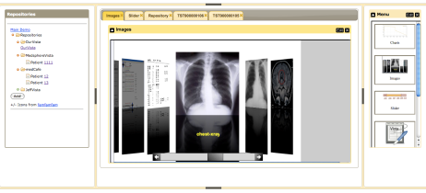





medCafe Architecture
Composable Framework
RESTful Web Services
CCR
Tabs
Coverflow
Date Slider
Image Viewers
Charts
Tomcat Web server
T
openVista
JAVA/ J2EE
Web Services
Additional
data servers
AJAX
medCafe Interface
Application server
Health-data server
medCafe architecture composed of multiple distinct, separable layers: front-end, application, loose coupler
and data server.
Notes:
This shows the architecture of the framework that we have built.
We have four distinct pieces that make up the medcafe composable framework.

Slide 8

Small Pieces (Components)
Independent framework and many small, independent pieces
Allows use of “Best of Breed” components
Prevents vendor lock-in
Can replace part of the UI if it is insufficient or a better one appears
Can replace (substitute) components when better ones become available
Easy to specialize
Purchase only what you need to cater to specialty
Smooth transition
Can start small and add capability over time
Notes:
Small components
Run standalone
Independent – can be added and dropped at will without affecting overall functionality
Allows Best of Breed

Slide 9
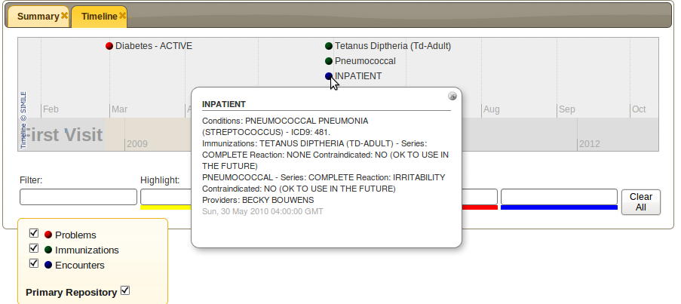
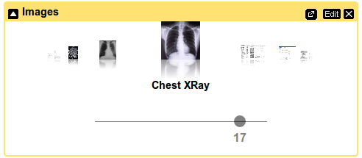
medCafe Components
Timeline visualizes patient history
Image viewer displays images and pdf
documents

Slide 10

User Defined Interface
Customizable via Component composition
User selects which components to use
Default views (templates)
Start with default collection of components
Good for those who don’t want to customize
Clinician defined views
Some specialists, advanced users wish to customize their view for their patients
Aligns with patient use cases
Per patient views
Some patients do not “fit the mold”
Modify a view for a specific patient and save it
Speeds re-engagement with a patient
Notes:
Templates:
Give physicians starting point to build from :
quick way to acquire various commonly required data
Template will be a default collection of components, labeled according to clinicians needs – e.g. PTSD
Specialists – specific needs

Slide 11

Loose Coupler: Consistent Access to Data
All data sources are presented in an identical format
Allows all components to speak the same language
Components can access all data the same way
Consistent method of access
Data sources transparent to user
More component choices -> more data sources willing to play
More data sources -> more component developers
Notes:
We access the data the same way using hData
All components can display this data format.
Display can be changed – without changing data
Data can be changed without changing Display

Slide 12
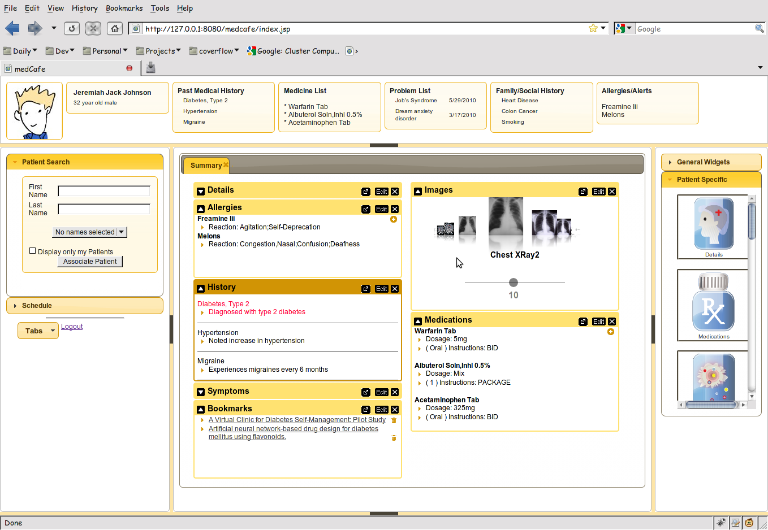
medCafe Interface
Top Pane: Coversheet containing commonly required patient data.
Left pane contains
Patient look up
and
scheduling functionality
Right hand pane contains list of
components that can be drag and dropped
into the center pane
Center pane contains composable patient record
Flexible 5 pane interface, adaptable to clinician’s needs. Panes can be hidden or shown.
Notes:
Framework overview:
5 major panes, North, South, etc,..
Can hide, show each pane.
Each pane can have multiple objects within it, such as tabs, widgets, sliders,treeviews etc,..

Slide 13
Demo
Notes:
Framework overview:
5 major panes, North, South, etc,..
Can hide, show each pane.
Each pane can have multiple objects within it, such as tabs, widgets, sliders,treeviews etc,..

Slide 14
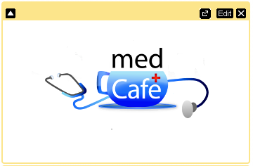




Adding A New Capability
Add New Component
Create and add a component + icon
Supply RESTful web URI for data
Add New Data Source
Determine if adaptor between hData and data source exists
If none exists, create adaptor to format target data source (hData)
Expose data source as RESTful service
Add RESTful URI to medCafe
View through default component
View using existing component
Add new component
For more details
Converting Data to GUI Component
Customizing Components
Adding a New Component
A
Adaptor
Data source
URI = Uniform Resource Identifier

Slide 15
MedCafe : Industry Feedback
From meeting with Open Health Tools
Rob Kolodner,
Chief Technology Officer for Open Health Tools
Former National Coordinator for Health IT
Skip McGaughey
(Executive Director) of Open Health Tools
Co Founder of Eclipse
“You solved a lot of the really hard problems”
“there are many who want to work to solve the next generation of the UI [user-defined GUIs], which you've already thought through most of”
From Demo to Clinical Groupware Collaborative
David Kibbe
Former Director of the Center for Health Information Technology for the American Academy of Family Physicians (AAFP)
“You have done some really strong stuff here”
Positively impacting how MITRE is viewed in
healthcare community

Slide 16
MedCafe : Industry Feedback
Veteran’s Affairs
Peter Levin (CTO)
“You have a very cool thing here!”
Doug Rosendale
Dir. of Joint Interoperability Ventures within the Veterans Health Administration (VHA) Office of Health Information (OHI)
“Wow – awesome,”
“I love the componentized nature of this.”
“You had me at drop box…”
Jim Demetriades (and Nancy Wilck)
Director, Emerging Health Technologies at Department of Veterans Affairs
“We tried to do something similar 5 years ago”
“You have (by accident) developed exactly the kind of GUI that users want…[they] want iGoogle interface”

Slide 17
Impacts External
OpenVista: Medsphere
Open Health Tools
Veterans Affairs: VistA Modernization
Clinical Groupware Collaboration
medJ
CCR to JSON Effort with David Kibbe
DoD/VA EHR Joint Presentation
VAi2
BlueButton
nexJ
vel2JS
Positively impacting how MITRE is viewed in
healthcare community

Slide 18
Impacts Internal
Health research proposals plan to leverage medCafe infrastructure
Patient Toolkit: Empowering patients to effectively coordinate their care
Closing the Gap – Integrating Person Device Data with Tunable Clinical Alerting and Workflows
DOD/EHR Joint Presentation Layer
Provided inputs to presentation layer requirement slides

Slide 19
What We Learned
Use Modular Methodology in System Design
Building a Pluggable Architecture is Key to Composability
Choosing Good Loose Couplers is Key

Slide 20
Use Modular Methodology in System Design
Underlying code structure is modular
Separate code into following layers
Infrastructure
Loose coupler (hData)
Presentation (through JQuery/ AJAX)
Data Layer (RESTful service layer)
Benefits
Minimizes impact on other sections if one has to be changed
E.g. If there were a federal mandate to use a different loose coupler, this code could be modified without impacting the system as a whole
Separate presentation layer completely from data layer for maximum flexibility

Slide 21
Building a Pluggable Architecture is Key
Best Practices
Each component communicates through one data standard
XML Configuration file used to list components available to system
Move to one configuration xml file per component
A list of functions that each component can perform should be enumerated and documented, for example:
Provide the ability to obtain a snapshot of the data contained in component at any time
Benefits
Allows for components to be swapped in and out of the
System (by an Administrator)
Presentation of the Patient Record (by the user)
Truly Composable System
System is adaptable to practices’ needs, individual clinicians needs and patient’s individual circumstance
System evolution is designed into the framework
Allows for Best of Breed of Components
Notes:
We access the data the same way using hData
All components can display this data format.
Display can be changed – without changing data
Data can be changed without changing Display

Slide 22
Determining a Good Loose Coupler is Key
Loose coupler is data standard around which components and services communicate
Best Practices
Loose coupler should be simple, optimized for most use cases (think KML)
hData/ CCR
C32 is too complex and will not be good loose coupler
Analyze current events / messages, look for 80% solution
Optimizing loose coupler to be used for all cases has drawbacks
Not optimized for performance
Will not be the best data standard for a single purpose
System may use multiple loose couplers
But components should only display information from a single format
“Extra” couplers should be built around real need
Images, Business Analytics
Benefits
If all components understand data context -> much richer user interface
Notes:
We access the data the same way using hData
All components can display this data format.
Display can be changed – without changing data
Data can be changed without changing Display

Slide 23
Important Points To Consider
Building a system to a composable, substituable design methodology is not easy
Design focus should be on building usable underlying framework not on user components
Goal is for components to evolve and adapt over time
Evolution of components and system HAS to be easy
First set of components should quickly become obsolete as new components become available
Build system as flexible as possible at the start, then build in constraints
Translation of source format to the loose coupler will be a large effort
Each service provider will need to provide data to this format, involving a large initial effort, possibly small return for first few components, may act as barrier to adoption

Slide 24
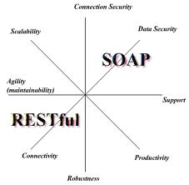
Important Points To Consider (cont)
Focus on Reuse
Where possible use / adapt existing components
Use existing presentation framework
JQuery enabled use of existing plug-ins
Allowed for extremely rapid development of components
Consider RESTful architectures
This framework is robust and flexible ^{[1]}
Allows for quick development and integration
Consider granularity of components in design
Chaining of components
Should be possible to chain together services and components for complex functionality
Dependencies on services
Where there is heavy dependency on a critical service or component, allow for duplication
[2]
¹MITRE Systems Engineering Guide, Composable Capabilities on Demand (CCoD)
²http://nicolas-zozol.developpez.com/tutorial/java/rest-jsp-english/

Slide 25

So It’s A Type of Portal? Right?
This is NOT a Portal Architecture
A plug and play architecture means substitutability of components
Portals do not allow for substitutability of components
Portals do not communicate through loose couplers
Providing web services without consideration of a loose coupler is not a path to a pluggable architecture
Interoperability is not the same as substitutability
Portal vendors have vested interest in NOT having substitutability, as will lose vendor ‘lock-in’
More complex than portal architecture
Gain is in having true substitutability and richer user experience, etc,.

Slide 26
Backup Slides

Slide 27
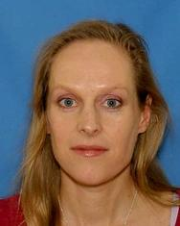

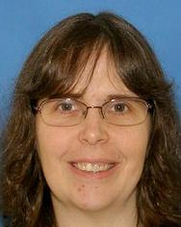
MedCafe People
Gail Hamilton (Pi) Jeff Hoyt (CoPi) Mary Greer
SME: Christian Donohue M.D.
VA Physician , Raleigh, Durham
National Primary Care Redesign Workgroup
Durham VA Systems Redesign Steering Committee
Durham VA Primary Care Redesign Committee
Notes:
Andy Gregorwitz: hData
Cheryl Clark: Medical Fact Extraction
David Harris: Categorization of discharge summaries PDFs
Christian Donohue M.D.:
National Primary Care Redesign Workgroup
Durham VA Systems Redesign Steering Committee
Durham VA Primary Care Redesign Committee
Dr. Donohue is currently a physician (since 2007) at the Department of Veterans Affairs, working at the Raleigh Clinic.
Jean Stanford, Mary Pulvemacher

Slide 28
MedCafe : Why Did We Do It?
Current VA Physician workflow not optimal
Streamline workflow through timelier data re-acquisition
Provide functionality to deal with physician ‘pain points’
Allow Physician rapid access to most pertinent data first
Design more intuitive interface modeling how physician would want to access data
We want to demonstrate ways to give
caregivers more time to do what matters most
Notes:
About 2 years ago, we were talking about some of the challenges CMS was facing with their medical records and realized that the work we were doing on CCOD would go a great way towards addressing those problems. We submitted a MIP proposal and that's when we found Dr. Christian Donahue (through Chris Spirito)and what we discovered was that the VA was facing similar issues (go to "current VA workflow" slide).

Slide 29
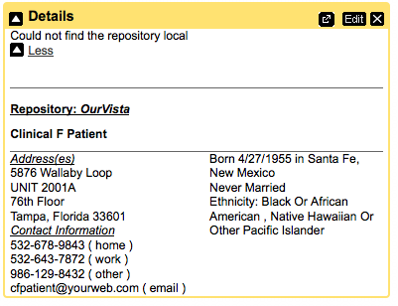
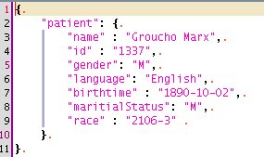
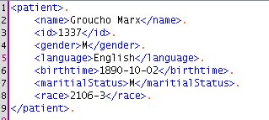
Converting Data to GUI
Converting hData to JSON
JavaScript is the language for dynamic web interfaces
Trivial mapping
Templates allow the transformation anywhere
Velocity and Velocity2JS
Remember all the formats (HTML, XML, JSON, etc.)?
Separates data from view
Component builder
Return to main slide

Slide 30
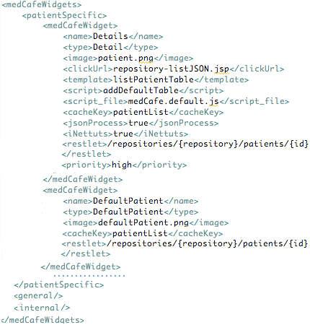
Adding a New Component
Specify Type
Patient, General, Internal
Data
Separate from Display
Restlet:
RESTful interface
Returns JSON data (XML/ hData)
Display
Separate from data
Template: (Velocity to JS) Formatting HTML from JSON
Script: Javascript for display formatting of HTML
Image
Optional: Defaults supplied
New components easily added
More refactoring planned….
Return to main slide
Notes:
For nice display, specify all parameters.
But most parameters are optional.
Only need to specify 5, and 3 are user specified, i,.e. Name, Type, (maybe concatenate into one?)
Only two pieces of information really required, the RESTful URI, accessing the formatted data
And an image icon to distinguish this component.

Slide 31
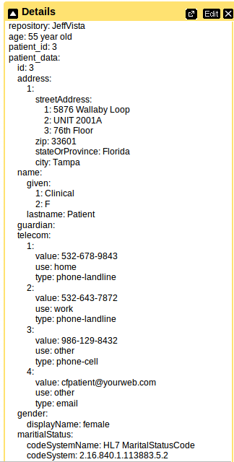
Customizing Components
Return to main slide
Notes:
Same data displayed in two different components. The first, all parameters full specified, using nicely formatted Details widget.
The second, with minimal parameters specified, using Default Widget. Data is displayed, but not ‘pretty’.

Slide 32
Scaling to Production
medCafe is a small research project
Highly scoped as proto-type system
Goal: Demonstrated feasibility of Composable architecture
Not a production level system
There are issues in scaling to Production
MedCafe specific
All Composable Systems

Slide 33
medCafe: Scaling to Production
Security infrastructure needs to exist
Single sign on
Vulnerability assessment
Role Based access
More…
User Interface issues
Scale interface for production level data sets
Share information (annotations) to all, roles, selected users
More…
Data Standards
Health data ontology
More…
Business rules enforced with Templates

Slide 34
All Systems: Scaling to Production
Governance
Managing component libraries
More…
Discoverability
Enable discoverability of components
More..
Test Framework
Develop Test Infrastructure framework for new components
Develop Test Criteria / Guidelines for Acceptance
More…
Service Access
Develop mechanism to alert user to service availability
Determine appropriate level of notification if unavailable
More…
Business Analytics
Develop capability to allow users to rate components and show component, system statistics
More…
Business Rules

Slide 35
Further Functionality
Patient Context Aware
Display most pertinent templates or components based on user role and patient information
Recommend components/ services to be used
Patient Consent Access
Connect to NHIN Connect
Chaining of components for complex functionality
Business rules for workflow would be required
Notes:
Certain pieces of the system will need to be modified if larger result sets are expected.
For example, patient search, with a drop down list is fine if there is only a few results. But if an advanced search is required, (to allow for searching on other parameters than patient name), a more sophisticated interface will be required.

Slide 36
What medCafe Has Shown Developer Perspective
medCafe completely Open Source framework
Can immediately build new capability as envisioned by users
Can enhance/ adapt any existing components to user needs
Able to build on existing JQuery interface plugins
No need to start from scratch
medCafe provides a more efficient way
to evolve the system and enhance capability

Slide 37
What medCafe Has Shown User Perspective
Physician can rapidly compose personal patient record
Display the most pertinent data first
System completely adaptable to changing patient circumstance
Ability to save state of record reduces time to reacquire patient data
If users think of desired capability they can help design new components
Data from multiple data sources may be transparently displayed to user
medCafe provides a more efficient way
for physicians to interact with patient record

Slide 38
What medCafe Has Shown Administrator’s Perspective
Can build the framework to practice’s needs
Can design system based on the capability practice cares about
Can start small, grow functionality over time
Can add new data sources as they become available
Can help design new components as new capabilities are envisioned
System completely adaptable to changing practice circumstances
Framework allows for ease of system evolution
Allows for Best of Breed
medCafe demonstrates feasibility of a completely composable
best of breed framework

Slide 39
MedCafe : Scaling to Production Security
Security
Single sign on infrastructure
RESTful services security infrastructure
Vulnerability Assessment (check for XSS etc,..)
Assign user individual login into database
Right now all users use same user credentials to access database
SSL
Role based access
Back to main presentation

Slide 40
MedCafe - Scaling to Production User Interface
Preparing User Interface for larger result sets
Patient Search interface
Template List Interface
Component List Interface
Data Entry
System is currently read-only, with exception of Note Editor
Enhance data entry through document based on pre-populated templates
Mechanism to take snapshot of data for audit purposes
Each component will present it’s own data snapshot
Mechanism to share information across system
User created and initial Templates
Annotations
Error handling
What happens when things go wrong?
Back to main presentation
Notes:
Certain pieces of the system will need to be modified if larger result sets are expected.
For example, patient search, with a drop down list is fine if there is only a few results. But if an advanced search is required, (to allow for searching on other parameters than patient name), a more sophisticated interface will be required.

Slide 41
MedCafe Scaling to Production Data Standards
Data Standards
Currently uses hData as ‘loose coupler’, but this is primarily data transport standard, still have to define patient data ontology standard
Back to main presentation
Notes:
Certain pieces of the system will need to be modified if larger result sets are expected.
For example, patient search, with a drop down list is fine if there is only a few results. But if an advanced search is required, (to allow for searching on other parameters than patient name), a more sophisticated interface will be required.

Slide 42
Scaling to Production Governance
Governance issues that would need to be addressed
Determine acceptable list of loose couplers
Determining list of functions that all components must supply
Recommended List
Produce data to loose coupler standard
Consume data in loose coupler standard
Save changed data in component
Report which services component can/ is allowed to interact
Mechanism to vet and approve new components
Determine which components are recommended/ official
Determine which services a component has access to
Determine if a component can access another component
Testing to determine component eligibility
Back to main presentation

Slide 43
Scaling to Production Discoverability
For system to be useful, need to enable discoverability of components
Options for discovering components
App store like web-site
Search capability within system
Search capability within a Open Source community
General internet search
Back to main presentation

Slide 44
Scaling to Production Testing
Develop Test Infrastructure framework for new components
Security
Functionality
Performance
Stress testing of system with new component
Develop Test Criteria for Acceptance
Guidelines for component performance acceptability
Guidelines for service performance/ availability
Back to main presentation

Slide 45
Scaling to Production Service Access
Service availability
Mechanism to alert user to service availability
May be unavailable due to service being down, or insufficient access rights
Determine if an alternate failover service is available
Determine what level of information to display if insufficient access rights, for example:
Not available with notification
Not available without notification
Back to main presentation
Notes:
Certain pieces of the system will need to be modified if larger result sets are expected.
For example, patient search, with a drop down list is fine if there is only a few results. But if an advanced search is required, (to allow for searching on other parameters than patient name), a more sophisticated interface will be required.

Slide 46
Scaling to Production Business Analytics
Mechanism to rate components by Users
Usability
Like/ Don’t Like
Mechanism to track component statistics
On availability
Performance
User Rating
Track service availability
Make statistics available to users/ component designers
Back to main presentation
Notes:
Certain pieces of the system will need to be modified if larger result sets are expected.
For example, patient search, with a drop down list is fine if there is only a few results. But if an advanced search is required, (to allow for searching on other parameters than patient name), a more sophisticated interface will be required.

Slide 47
medCafe & Patient Consent
Java* + Metadata
Metadata
medCafe UI
medCafe
wrapper
CDB
Java
XACML
Resu l tSe t
SQL+XACML
Record System
PEP
XML
SQL
Notes:
MedCafe + Patient Consent Management through enforceable policy,
“The goal of Patient Consent Management project is to develop an infrastructure that allows patients to communicate their privacy preferences to anyone maintaining health information on their behalf. These preferences indicate the situations under which the patient consents to share data (obviating the need to re-obtain consent for each transfer of data). We are developing a prototype that allows us to explore the policy issues that arise when scaling to a nationwide consent management system and to show how privacy preferences can be exchanged in an enforceable, automated, form.”

Slide 48
MedCafe Caching Architecture
MedCafe Data
RetrievePatient.jsp
CachePatient.jsp
JSON
PatientCache Java Object
List of RESTful URIs
DataSouce.xml
<XML>
MedCafe Display
MedCafe Component
PatientCache Java Object
JSON Data
HTML
Widget Wrapper
(innettus.js)
Javascript for
Component
Velocity to JS Template
WidgetList <XML>

Slide 49
Possible Additional Components
Speech to Text
Transcribe doctors dictation notes
Alerts
Alert other clinicians through system, rather than email
Email, paper to patient automatically through system
Automatically call patient, leave text message
Note plugin
allow for cutting and pasting from other components

Slide 50
Collaborations
Meeting with Christian Donohue April 30th.
Continue working meetings with him
Feedback at http://mitrepedia.mitre.org/index.php/MedCafe
LAIKA (Andy Gregorowicz, existing work)
Provide data, hData
Automating Fact Extraction from Medical Records, (Cheryl Clark, proposed MSR)
Medical fact extraction to enhance “outside record” categorization
Security: Enforceable Specification of Policy (Peter Mork)
Using OpenVista instance
Multimodal Medical Data Capture and Representation (Qian Hu, existing MSR)
Speech to text capability
Notes:
We have been actively collaborating with both Andy Gregorowicz for hData.
And Cheryl Clark. Who have supplied us with pdfs of discahrge papers.
Are not yet ready to engage with Qian fpr Speech to text facility. Expect that this will happen 2nd to 3rd quarter.

Slide 51
SME Background
Work closely with SME
Christian Donohue, M.D. (Durham Medical Center, NC)
National Primary Care Redesign Workgroup
Durham VA Systems Redesign Steering Committee
Durham VA Primary Care Redesign Committee
Notes:
In April 2007 he started at the Department of Veterans. In early 2009 he was a asked to be a member of the VA’s national workgroup for primary care redesign. He sits on the Durham VA System Redesign committee and has been involved in several practice improvement projects for the Raleigh Clinic.
Dr. Donohue is currently a physician at the Department of Veterans Affairs, working at the Raleigh Clinic. His qualifications include attending medical school at Tufts University in Boston, residency at Thomas Jefferson University Hospital in Philadelphia, and assistant professorship at Duke University Medical Center.
He currently is a member of the VA’s national workgroup for primary care redesign, since early 2009, when he was asked to become a member. He sits on the Durham VA System Redesign committee and is involved in several practice improvement projects for the Raleigh Clinic.

Slide 52
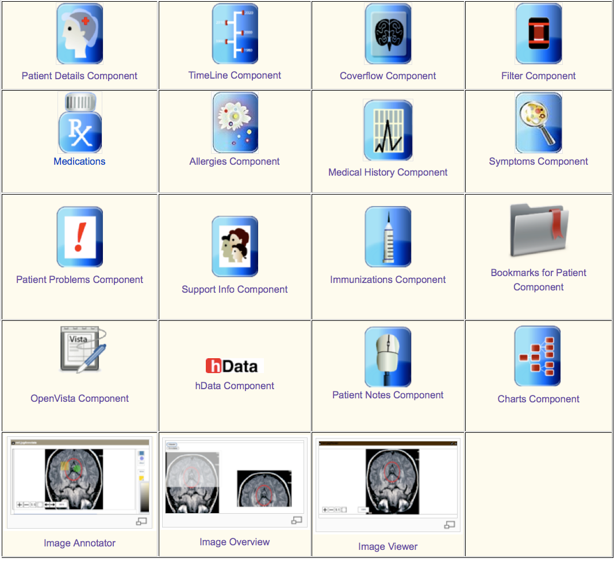
MedCafe Components

Slide 53
MedCafe Future Plans
Open sourcing of Code
Web presence
External medCafe server
Industry Reach out
White paper
Conference presentation
Document architecture
“Plugin Guide”

Slide 54
SME Wish List for Functionality
New Ways to Visualize Data
Coverflow for images
Timeline showing all appointments, visits, dates of medications, hospitalizations
Image functionality
Categorize and filter, Annotations, and share annotations , Highlight action, Tag documents with keywords and share tags
Patient Coversheet
Vital signs, Medications List, Allergies, Alerts, Past Medical History. Personal and Family (prioritized), Social History, Patient Photo, Future Appointments
New Modalities
Video, Sound (Electronic Stethoscope), Voice Recognition with transcription
Integration of categorized pdfs
And ability to add new data / tools as they become available Back

Slide 55
EHR: The Way Forward?
VA VistA Modernization
ACT-IAC Vista Modernization
Carnegie Mellon report recommending Open Source solution for VistA
Patient Centric approach
Clinical Groupware
ONC commits $60 million to 4 grants to solve EHR problems
Harvard SMART (Substitutable Medical Applications, Re-useable Technology) $15 million
“The approach could impact both the EHR industry…..(in) 1-3 years”¹
Clinical Groupware Consortium
New Data Delivery Platforms
iPad Apps, smart phone apps,..
Modularization Certification
HHS Certification process ("meaningful use of certified EHR technology”) for modular apps
CCHIT certification program for components of EHRs
¹http://www.thehealthcareblog.com/the_health_care_blog/2010/10/update-on-modular-ehr-technology-harvards-smart-research.html
Notes:
SMART: creating a “medical apps store” based on the iPhone/iPad model of substitutable applications running on a device or platform.
The approach could impact both the EHR industry and the federal regulatory and standards process, possibly within a relatively short period, i.e., 1-3 years, so we think it merits your attention.
ONC: Office of the National Coordinator for Health Information Technology

Slide 56
MedCafe : Why What We Did Matters!
Truly Modular EHR
Incorporating idea of “Substitutability”, allowing for Best of Breed
Leading edge prototype for Healthcare
Architecture arrived at with MITRE expertise / knowledge before rest of Healthcare
At the forefront of Healthcare IT
Ahead of any current implementation using this approach
Our budget: ~ 400k, SMART budget: 15 million
Scalable architecture
Prototype that shows viability of approach
iPad interaction via “Gestures”
Interfaces with OpenVista
As close to current VA repository as possible
Open source, business friendly license
Any vendor or organization can take code base and adapt/ enhance

Slide 57
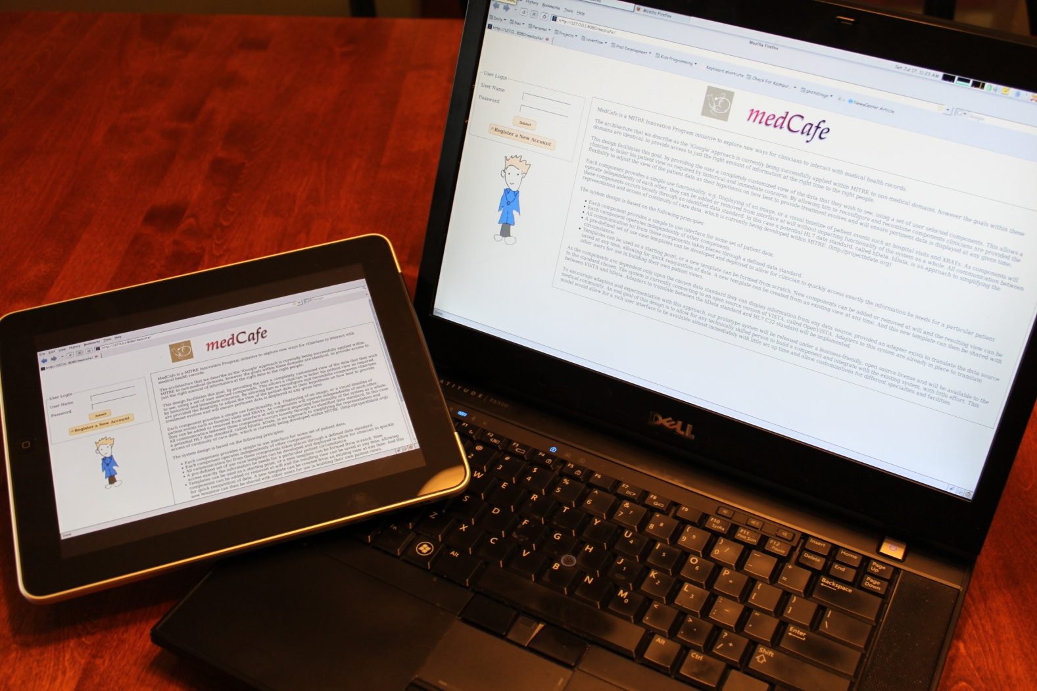
New Delivery Platforms
Notes:
iPad delivery through Browser. Added Touch gestures to allow for interfacing with data.

